Slide 1
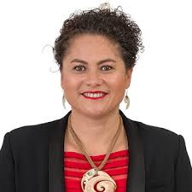
Louisa Wall
By Wi Anaru

Slide 2
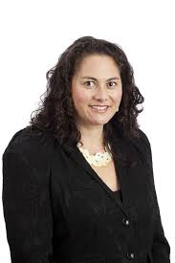
All About Her
Born: 17th February 1972, Taupo, New Zealand
Age= 45 years old
Political Party= Labour
Education= Taupo-nui-a-Tia College
Sports: She played with the silver ferns in netball at the age of 17. And played rugby for the Black Ferns.

Slide 3
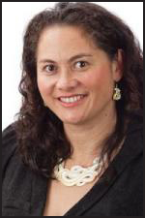
How did she became an MP
Louisa Wall is an member in Parliament and she became a labour party MP on the 4th of March in 2008. Also Louisa Wall is a Labour MP for Manurewa in South Auckland. Did you know she has been an MP for nine years.

Slide 4
Thank you for Reading

